Slide 1
Data and Computer Communications
Chapter 19 – Internetwork Operation
Ninth Edition
by William Stallings
Notes:
“Data and Computer Communications”, 9/e, by William Stallings, Chapter 19 “Internetwork Operation”.

Slide 2
Internetwork Operation
Prior to the recent explosion of sophisticated research, scientists believed that birds required no special awareness or intelligence to perform their migrations and their navigational and homing feats. Accumulated research shows that in addition to performing the difficult tasks of correcting for displacement (by storms, winds, mountains, and other hindrances), birds integrate an astonishing variety of celestial, atmospheric, and geological information to travel between their winter and summer homes. In brief, avian navigation is characterized by the ability to gather a variety of informational cues and to interpret and coordinate them so as to move closer toward a goal.
—The Human Nature of Birds,
Theodore Barber
Notes:
This quote is from the start of Stallings DCC9e Chapter 19.

Slide 3
Multicasting
sending packet to addresses referring to group of hosts on one or more networks
multimedia “broadcast”
teleconferencing
database
distributed computing
real time workgroups
Notes:
Typically, an IP address refers to an individual host on a particular network. IP also accommodates addresses that refer to a group of hosts on one or more networks. Such addresses are referred to as multicast addresses, and the act of sending a packet from a source to the members of a multicast group is referred to as multicasting.
Multicasting has a number of practical applications. For example,
Multimedia: A number of users "tune in" to a video or audio transmission from a multimedia source station.
Teleconferencing: A group of workstations form a multicast group such that a transmission from any member is received by all other group members.
Database: All copies of a replicated file or database are updated at the same time.
Distributed computation: Intermediate results are sent to all participants.
Real-time workgroup: Files, graphics, and messages are exchanged among active group members in real time.

Slide 4
LAN Multicast
easy!
LAN multicast is easy
send to IEEE 802 multicast MAC address
those in multicast group will accept it
only single copy of packet is needed
a transmission from any one station is received by all other stations on LAN
Notes:
Multicasting done within the scope of a single LAN segment is straightforward. IEEE 802 and other LAN protocols include provision for MAC-level multicast addresses. A packet with a multicast address is transmitted on a LAN segment. Those stations that are members of the corresponding multicast group recognize the multicast address and accept the packet. In this case, only a single copy of the packet is ever transmitted. This technique works because of the broadcast nature of a LAN: a transmission from any one station is received by all other stations on the LAN.

Slide 5
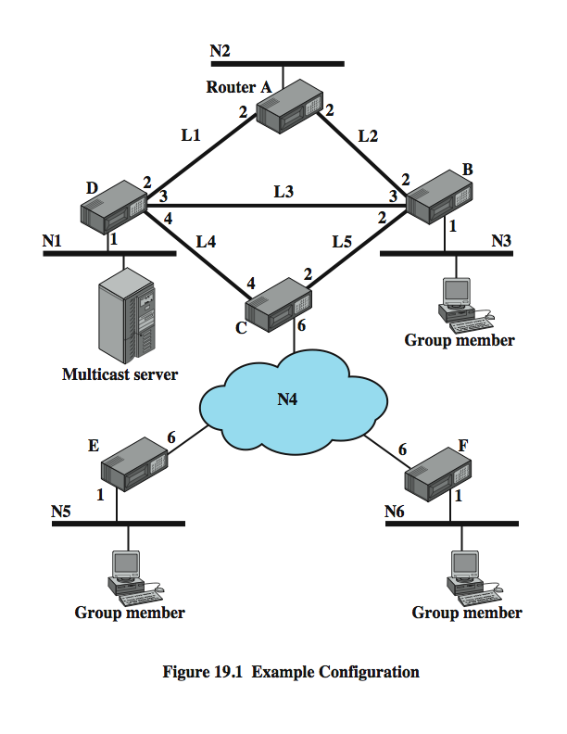
Example Configuration
Notes:
In an internet environment, multicasting is a far more difficult undertaking. To see this, consider the configuration of Stallings DCC9e Figure 19.1; a number of LANs are interconnected by routers. Routers connect to each other either over high-speed links or across a wide area network (network N4). A cost is associated with each link or network in each direction, indicated by the value shown leaving the router for that link or network. Suppose that the multicast server on network N1 is transmitting packets to a multicast address that represents the workstations indicated on networks N3, N5, N6.

Slide 6
Broadcast / Multiple Unicast / Multicast
broadcast packet to each network
if server does not know members of group
requires 13 packets
could send multiple unicast packets
to each network with members in multicast group
requires 11 packets
true multicast
spanning tree
replicated by routers at branch points
requires 8 packets
Notes:
Suppose that the server does not know the location of the members of the multicast group. Then one way to assure that the packet is received by all members of the group is to broadcast a copy of each packet to each network in the configuration, over the least-cost route for each network. For example, one packet would be addressed to N3 and would traverse N1, link L3, and N3. Router B is responsible for translating the IP-level multicast address to a MAC-level multicast address before transmitting the MAC frame onto N3
Now suppose the source system knows the location of each member of the multicast group. That is, the source has a table that maps a multicast address into a list of networks that contain members of that multicast group. In that case, the source need only send packets to those networks that contain members of the group. We could refer to this as the multiple unicast strategy. Stallings DCC9e Table 19.1 shows that in this case, 11 packets are required.
Both the broadcast and multiple unicast strategies are inefficient because they generate unnecessary copies of the source packet. In a true multicast strategy, the following method is used:
1. The least-cost path from the source to each network that includes members of the multicast group is determined. This results in a spanning tree of the configuration. Note that this is not a full spanning tree of the configuration. Rather, it is a spanning tree that includes only those networks containing group members.
2. The source transmits a single packet along the spanning tree.
3. The packet is replicated by routers only at branch points of the spanning tree.

Slide 7
Traffic Generated by Various Multicasting Strategies
Notes:
StallingsDCC9eTable 19.1 summarizes the number of packets generated on the various links and networks in order to transmit one packet to a multicast group by this method. In this table, the source is the multicast server on network N1 in Figure 19.1; the multicast address includes the group members on N3, N5, and N6

Slide 8
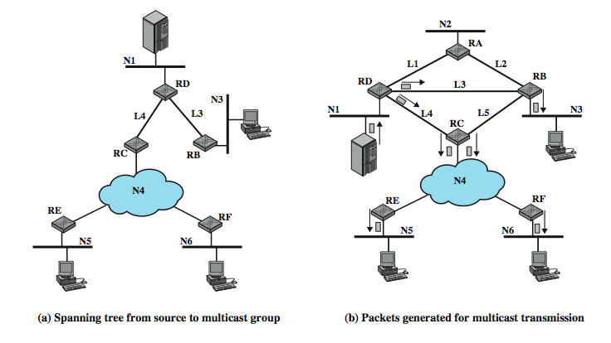
Multicast Example
Notes:
Stallings DCC9e Figure 19.2a shows the spanning tree for transmissions from the source to the multicast group, and Figure 19.2b shows this method in action. The source transmits a single packet over N1 to router D. D makes two copies of the packet, to transmit over links L3 and L4. B receives the packet from L3 and transmits it on N3, where it is read by members of the multicast group on the network. Meanwhile, C receives the packet sent on L4. It must now deliver that packet to both E and F. If network N4 were a broadcast network (e.g., an IEEE 802 LAN), then C would only need to transmit one instance of the packet for both routers to read. If N4 is a packet-switching WAN, then C must make two copies of the packet and address one to E and one to F. Each of these routers, in turn, retransmits the received packet on N5 and N6, respectively. As Table 19.1 shows, the multicast technique requires only eight copies of the packet.

Slide 9
Requirements for Multicasting
router may have to forward more than one copy of packet
need convention to identify multicast addresses (IPv4, Class D, IPv6)
nodes translate between IP multicast addresses and list of networks containing group members
router must translate between IP multicast address and network multicast address
Cont…
Notes:
In ordinary unicast transmission over an internet, in which each datagram has a unique destination network, the task of each router is to forward the datagram along the shortest path from that router to the destination network. With multicast transmission, the router may be required to forward two or more copies of an incoming datagram. In our example, routers D and C both must forward two copies of a single incoming datagram.
Thus, we might expect that the overall functionality of multicast routing is more complex than unicast routing. The following is a list of required functions:
1. A convention is needed for identifying a multicast address. In IPv4, Class D addresses are reserved for this purpose. These are 32-bit addresses with 1110 as their high-order 4 bits, followed by a 28-bit group identifier. In IPv6, a 128-bit multicast address consists of an 8-bit prefix of all ones, a 4-bit flags field, a 4-bit scope field, and a 112-bit group identifier. The flags field, currently, only indicates whether this address is permanently assigned or not. The scope field indicates the scope of applicability of the address, ranging from a single network to global.
2. Each node (router or source node participating in the routing algorithm) must translate between an IP multicast address and a list of networks that contain members of this group. This information allows the node to construct a shortest-path spanning tree to all of the networks containing group members.
3. A router must translate between an IP multicast address and a network multicast address in order to deliver a multicast IP datagram on the destination network. For example, in IEEE 802 networks, a MAC-level address is 48 bits long; if the highest-order bit is 1, then it is a multicast address. Thus, for multicast delivery, a router attached to an IEEE 802 network must translate a 32-bit IPv4 or a 128-bit IPv6 multicast address into a 48-bit IEEE 802 MAC-level multicast address.

Slide 10
Requirements for Multicasting
mechanism required for hosts to join and leave multicast group
routers must exchange information
which networks include members of given group
sufficient information to work out shortest path to each network
routing algorithm to calculate shortest path
routers must determine routing paths based on source and destination addresses
Notes:
4. Although some multicast addresses may be assigned permanently, the more usual case is that multicast addresses are generated dynamically and that individual hosts may join and leave multicast groups dynamically. Thus, a mechanism is needed by which an individual host informs routers attached to the same network as itself of its inclusion in and exclusion from a multicast group. IGMP, described subsequently, provides this mechanism.
5. Routers must exchange two sorts of information. First, routers need to know which networks include members of a given multicast group. Second, routers need sufficient information to calculate the shortest path to each network containing group members. These requirements imply the need for a multicast routing protocol. A discussion of such protocols is beyond the scope of this book.
6. A routing algorithm is needed to calculate shortest paths to all group members.
7. Each router must determine multicast routing paths on the basis of both source and destination addresses.

Slide 11
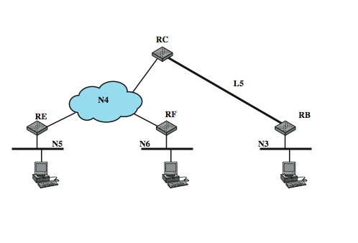
Spanning Tree from Router C to Multicast Group
Notes:
The last point is a subtle consequence of the use of multicast addresses. To illustrate the point, consider again Stallings DCC9e Figure 19.1. If the multicast server transmits a unicast packet addressed to a host on network N5, the packet is forwarded by router D to C, which then forwards the packet to E. Similarly, a packet addressed to a host on network N3 is forwarded by D to B. But now suppose that the server transmits a packet with a multicast address that includes hosts on N3, N5, and N6. As we have discussed, D makes two copies of the packet and sends one to B and one to C. What will C do when it receives a packet with such a multicast address? C knows that this packet is intended for networks N3, N5, and N6. A simple-minded approach would be for C to calculate the shortest path to each of these three networks. This produces the shortest-path spanning tree shown in Stallings DCC9e Figure 19.3. As a result, C sends two copies of the packet out over N4, one intended for N5 and one intended for N6. But it also sends a copy of the packet to B for delivery on N3. Thus B will receive two copies of the packet, one from D and one from C. This is clearly not what was intended by the host on N1 when it launched the packet.
To avoid unnecessary duplication of packets, each router must route packets on the basis of both source and multicast destination. When C receives a packet intended for the multicast group from a source on N1, it must calculate the spanning tree with N1 as the root (shown in Figure 19.2a) and route on the basis of that spanning tree.

Slide 12
Internet Group Management Protocol (IGMP)
RFC 3376 used to exchange multicast group information between hosts & routers on a LAN
hosts send messages to routers to subscribe and unsubscribe from multicast group
routers check which multicast groups are of interest to which hosts
IGMP currently at version 3
Notes:
IGMP, defined in RFC 3376, is used by hosts and routers to exchange multicast group membership information over a LAN. IGMP takes advantage of the broadcast nature of a LAN to provide an efficient technique for the exchange of information among multiple hosts and routers. In general, IGMP supports two principal operations:
1. Hosts send messages to routers to subscribe to and unsubscribe from a multicast group defined by a given multicast address.
2. Routers periodically check which multicast groups are of interest to which hosts.

Slide 13
Operation of IGMP v1 & v2
IGMPv1
hosts could join group
routers used timer to unsubscribe members
IGMPv2 enabled hosts to unsubscribe
operational model:
receivers have to subscribe to groups
sources do not have to subscribe to groups
any host can send traffic to any multicast group
problems:
spamming of multicast groups
establishment of distribution trees is problematic
finding globally unique multicast addresses difficult
Notes:
In IGMPv1, hosts could join a multicast group and routers used a timer to unsubscribe group members. IGMPv2 enabled a host to request to be unsubscribed from a group. The first two versions used essentially the following operational model:
Receivers have to subscribe to multicast groups.
Sources do not have to subscribe to multicast groups.
Any host can send traffic to any multicast group.
This paradigm is very general, but it also has some weaknesses:
1. Spamming of multicast groups is easy. Even if there are application level filters to drop unwanted packets, still these packets consume valuable resources in the network and in the receiver that has to process them.
2. Establishment of the multicast distribution trees is problematic. This is mainly because the location of sources is not known.
3. Finding globally unique multicast addresses is difficult. It is always possible that another multicast group uses the same multicast address.

Slide 14
IGMP v3
addresses weaknesses by:
allowing hosts to specify list from which they want to receive traffic
blocking traffic from other hosts at routers
allowing hosts to block packets from sources that send unwanted traffic
Notes:
IGMPv3 addresses these weaknesses by
1. Allowing hosts to specify the list of hosts from which they want to receive traffic. Traffic from other hosts is blocked at routers.
2. Allowing hosts to block packets that come from sources that send unwanted traffic.

Slide 15
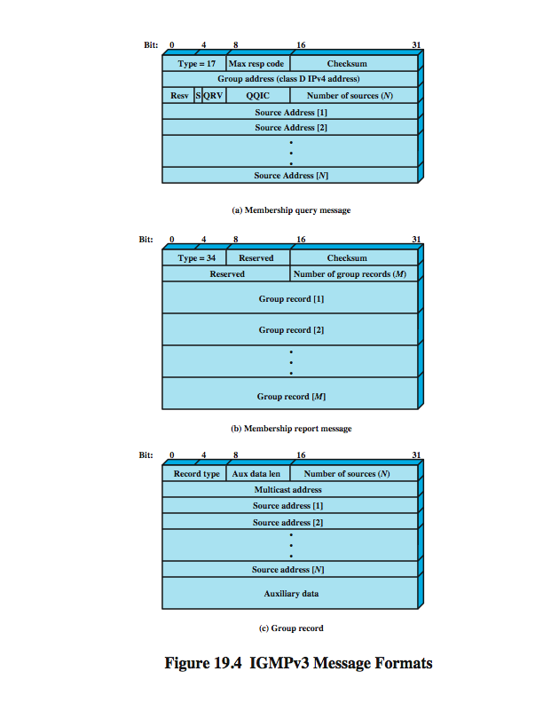
IGMP Message Formats Membership Query
sent by multicast router
three subtypes: general query, group-specific query, group-and-source specific query
Notes:
All IGMP messages are transmitted in IP datagrams. The current version defines two message types: Membership Query and Membership Report.
A Membership Query message is sent by a multicast router. There are three subtypes: a general query, used to learn which groups have members on an attached network; a group-specific query, used to learn if a particular group has any members on an attached network; and a group-and-source specific query, used to learn if any attached device desires reception of packets sent to a specified multicast address, from any of a specified list of sources.
Stallings DCC9e Figure 19.4a shows the message format, which consists of the following fields:
Type: Defines this message type.
Max Response Code: Indicates the maximum allowed time before sending a responding report in units of 1/10 second.
Checksum: An error-detecting code, calculated as the 16-bit ones complement addition of all the 16-bit words in the message. For purposes of computation, the Checksum field is itself initialized to a value of zero. This is the same checksum algorithm used in IPv4.
Group Address: Zero for a general query message; a valid IP multicast group address when sending a group-specific query or group-and-source-specific query.
S Flag: When set to one, indicates to any receiving multicast routers that they are to suppress the normal timer updates they perform upon hearing a query.
QRV (querier's robustness variable): If nonzero, the QRV field contains the RV value used by the querier (i.e., the sender of the query). Routers adopt the RV value from the most recently received query as their own RV value, unless that most recently received RV was zero, in which case the receivers use the default value or a statically configured value. The RV dictates how many times a host will retransmit a report to assure that it is not missed by any attached multicast routers.
QQIC (querier's querier interval code): Specifies the QI value used by the querier, which is a timer for sending multiple queries. Multicast routers that are not the current querier adopt the QI value from the most recently received query as their own QI value, unless that most recently received QI was zero, in which case the receiving routers use the default QI value.
Number of Sources: Specifies how many source addresses are present in this query. This value is nonzero only for a group-and-source specific query.
Source Addresses: If the number of sources is N, then there are N 32-bit unicast addresses appended to the message.

Slide 16
Membership Query Fields
type
max response time
checksum
group address
S flag
QRV (querier's robustness variable)
QQIC (querier's querier interval code)
number of sources
source addresses
Notes:
The IGMP membership query message has the following fields:
Type: message type.
Max Response Code: maximum allowed time before sending a responding report in units of 1/10 second.
Checksum: error-detecting code, calculated as the 16-bit ones complement sum of all 16-bit words in message. This is the same as used in IPv4.
Group Address: Zero for a general query message; a valid IP multicast address for a group-specific query or group-and-source-specific query.
S Flag: indicates to any receiving multicast routers that they are to suppress the normal timer updates they perform upon hearing a query.
QRV (querier's robustness variable): If nonzero, the QRV field contains the RV value used by the querier (i.e., the sender of the query). The RV dictates how many times a host will retransmit a report to assure that it is not missed by any attached multicast routers.
QQIC (querier's querier interval code): Specifies the QI value used by the querier, which is a timer for sending multiple queries.
Number of Sources: Specifies number source addresses in this query. This value is nonzero only for a group-and-source specific query.
Source addresses: If the number of sources is N, then there are N 32-bit unicast addresses appended to the message.

Slide 17
IGMP Message Formats Membership Report
Notes:
Stallings DCC9e Figure 19.4b shows the message format of an IGMP Membership Report message, which has the following fields:
Type: Defines this message type.
Checksum: An error-detecting code, calculated as the 16-bit ones complement addition of all the 16-bit words in the message.
Number of Group Records: Specifies how many group records are present in this report.
Group Records: If the number of group records is M, then there are M 32-bit unicast group records appended to the message.

Slide 18
IGMP Message Formats Group Record
Notes:
Stallings DCC9e Figure 19.4c shows the format of the group record in an IGMP Membership Report message. This has the following fields:
Record Type: Defines this record type, as described subsequently.
Aux Data Length: Length of the auxiliary data field, in 32-bit words.
Number of Sources: Specifies how many source addresses are present in this record.
Multicast Address: The IP multicast address to which this record pertains.
Source Addresses: If the number of sources is N, then there are N 32-bit unicast addresses appended to the message.
Auxiliary Data: Additional information pertaining to this record. Currently, no auxiliary data values are defined.

Slide 19
IGMP Operation - Joining
IGMP host wants to make itself known as group member to other hosts and routers on LAN
IGMPv3 can signal group membership with filtering capabilities with respect to sources
EXCLUDE mode – all members except those listed
INCLUDE mode – only from group members listed
to join send IGMP membership report message
address field multicast address of group
sent in IP datagram
current group members receive & learn new member
routers listen to all IP multicast addresses to hear all reports
Notes:
The objective of each host in using IGMP is to make itself known as a member of a group with a given multicast address to other hosts on the LAN and to all routers on the LAN. IGMPv3 introduces the ability for hosts to signal group membership with filtering capabilities with respect to sources. A host can either signal that it wants to receive traffic from all sources sending to a group except for some specific sources (called EXCLUDE mode) or that it wants to receive traffic only from some specific sources sending to the group (called INCLUDE mode). To join a group, a host sends an IGMP membership report message, in which the multicast address field is the multicast address of the group. This message is sent in an IP datagram with the same multicast destination address. In other words, the Multicast Address field of the IGMP message and the Destination Address field of the encapsulating IP header are the same. All hosts that are currently members of this multicast group will receive the message and learn of the new group member. Each router attached to the LAN must listen to all IP multicast addresses in order to hear all reports.

Slide 20
IGMP Operation – Keeping Lists Valid
router doesn’t know every host in a group
needs to know at least one group member still active
each host in group sets timer with random delay
host hearing another report cancels own
if timer expires, host sends report
only one member of each group reports to router
routers periodically issue IGMP general query message
in datagram with all-hosts multicast address
hosts must read such datagrams
hosts respond with report message
Notes:
To maintain a valid current list of active group addresses, a multicast router periodically issues an IGMP general query message, sent in an IP datagram with an all-hosts multicast address. Each host that still wishes to remain a member of one or more multicast groups must read datagrams with the all-hosts address. When such a host receives the query, it must respond with a report message for each group to which it claims membership.
Note that the multicast router does not need to know the identity of every host in a group. Rather, it needs to know that there is at least one group member still active. Therefore, each host in a group that receives a query sets a timer with a random delay. Any host that hears another host claim membership in the group will cancel its own report. If no other report is heard and the timer expires, a host sends a report. With this scheme, only one member of each group should provide a report to the multicast router.

Slide 21
IGMP Operation - Leaving
host leaves group by sending a leave group message to the all-routers static multicast address
sends a membership report message with EXCLUDE option and null list of source addresses
router determines if have any remaining group members using group-specific query message
Notes:
When a host leaves a group, it sends a leave group message to the all-routers static multicast address. This is accomplished by sending a membership report message with the INCLUDE option and a null list of source addresses; that is, no sources are to be included, effectively leaving the group. When a router receives such a message for a group that has group members on the reception interface, it needs to determine if there are any remaining group members. For this purpose, the router uses the group-specific query message.

Slide 22
Group Membership with IPv6
IGMP defined for IPv4
uses 32-bit addresses
IPv6 internets need functionality
IGMP functions included in Internet Control Message Protocol v6 (ICMPv6)
ICMPv6 has functionality of ICMPv4 & IGMP
ICMPv6 includes group-membership query and group-membership report message
Notes:
IGMP was defined for operation with IPv4 and makes use of 32-bit addresses. IPv6 internets need this same functionality. Rather than to define a separate version of IGMP for IPv6, its functions have been incorporated into the new version of the Internet Control Message Protocol (ICMPv6). ICMPv6 includes all of the functionality of ICMPv4 and IGMP. For multicast support, ICMPv6 includes both a group-membership query and a group-membership report message, which are used in the same fashion as in IGMP.

Slide 23
Routing Protocols
routers receive and forward packets
make decisions based on knowledge of topology and traffic / delay conditions
use dynamic routing algorithm
distinguish between
routing information - about topology and delays
routing algorithm - makes routing decisions based on information
Notes:
The routers in an internet are responsible for receiving and forwarding packets through the interconnected set of networks. Each router makes routing decision based on knowledge of the topology and traffic/delay conditions of the internet. In a simple internet, a fixed routing scheme is possible. In more complex internets, a degree of dynamic cooperation is needed among the routers. In particular, the router must avoid portions of the network that have failed and should avoid portions of the network that are congested. To make such dynamic routing decisions, routers exchange routing information using a special routing protocol for that purpose. Information is needed about the status of the internet, in terms of which networks can be reached by which routes, and the delay characteristics of various routes.
In considering the routing function, it is important to distinguish two concepts:
Routing information: Information about the topology and delays of the internet
Routing algorithm: The algorithm used to make a routing decision for a particular datagram, based on current routing information

Slide 24
Autonomous Systems (AS)
a group of routers and networks managed by a single organization
exchange information via a common routing protocol
form a connected network
at least one path between any pair of nodes, except in times of failure
Notes:
To proceed with our discussion of routing protocols, we need to introduce the concept of an autonomous system. An autonomous system (AS) exhibits the following characteristics:
1. An AS is a set of routers and networks managed by a single organization.
2. An AS consists of a group of routers exchanging information via a common routing protocol.
3. Except in times of failure, an AS is connected (in a graph-theoretic sense); that is, there is a path between any pair of nodes.

Slide 25
Interior Router Protocol & Exterior Routing Protocol
interior router protocol (IRP)
passes routing information between routers within AS
can be tailored to specific applications
needs detailed model of network to function
may have more than one AS in internet
routing algorithms & tables may differ between them
routers need information on networks outside their own AS
use an exterior router protocol (ERP) for this
supports summary information on AS reachability
Notes:
A shared routing protocol, which we shall refer to as an interior router protocol (IRP), passes routing information between routers within an AS. The protocol used within the AS does not need to be implemented outside of the system. This flexibility allows IRPs to be custom tailored to specific applications and requirements.
It may happen, however, that an internet will be constructed of more than one AS. For example, all of the LANs at a site, such as an office complex or campus, could be linked by routers to form an AS. This system might be linked through a wide area network to other ASs. The situation is illustrated in Stallings DCC9e Figure 19.5. In this case, the routing algorithms and information in routing tables used by routers in different ASs may differ. Nevertheless, the routers in one AS need at least a minimal level of information concerning networks outside the system that can be reached. We refer to the protocol used to pass routing information between routers in different ASs as an exterior router protocol (ERP).
We can expect that an ERP will need to pass less information than an IRP, for the following reason. If a datagram is to be transferred from a host in one AS to a host in another AS, a router in the first system need only determine the target AS and devise a route to get into that target system. Once the datagram enters the target AS, the routers within that system can cooperate to deliver the datagram; the ERP is not concerned with, and does not know about, the details of the route followed within the target AS.
In the remainder of this section, we look at what are perhaps the most important examples of these two types of routing protocols: BGP and OSPF. But first, it is useful to look at a different way of characterizing routing protocols.
In the literature, the terms interior gateway protocol (IGP) and exterior gateway protocol (EGP) are often used for what are referred to here as IRP and ERP. However, because the terms IGP and EGP also refer to specific protocols, we avoid their use to define the general concepts.

Slide 26
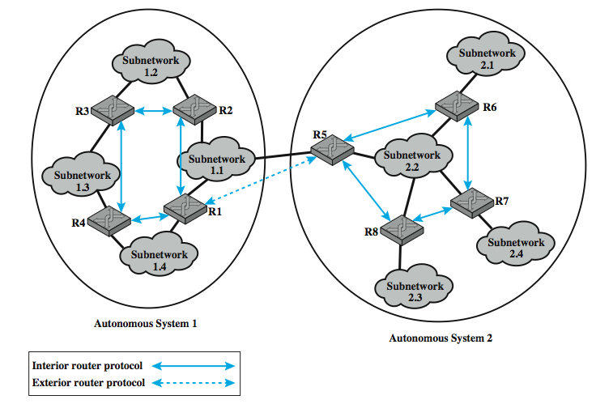
Application of IRP and ERP
Notes:
Illustrate the use of an interior router protocol (IRP) vs an exterior router protocol (ERP) in this example. Here, all of the LANs at a site, such as an office complex or campus, could be linked by routers to form an AS. This system might be linked through a wide area network to other ASs. The situation is illustrated in Stallings DCC9e Figure 19.5.

Slide 27
Approaches to Routing – Distance-vector
each node (router or host) exchanges information with neighboring nodes
first generation routing algorithm for ARPANET
each node maintains vector of link costs for each directly attached network and distance and next-hop vectors for each destination
requires transmission of considerable information by routers
distance vector and estimated path costs
changes could take a long time to propagate
Notes:
Internet routing protocols employ one of three approaches to gathering and using routing information: distance-vector routing, link-state routing, and path-vector routing.
Distance-vector routing requires that each node (router or host that implements the routing protocol) exchange information with its neighboring nodes. Two nodes are said to be neighbors if they are both directly connected to the same network. This approach is that used in the first generation routing algorithm for ARPANET, as described in Section 12.2. For this purpose, each node maintains a vector of link costs for each directly attached network and distance and next-hop vectors for each destination. The relatively simple Routing Information Protocol (RIP) uses this approach.
Distance-vector routing requires the transmission of a considerable amount of information by each router. Each router must send a distance vector to all of its neighbors, and that vector contains the estimated path cost to all networks in the configuration. Furthermore, when there is a significant change in a link cost or when a link is unavailable, it may take a considerable amount of time for this information to propagate through the internet.

Slide 28
Approaches to Routing – Link-state
designed to overcome drawbacks of distance-vector
each router determines link cost on each interface
advertises set of link costs to all other routers in topology
if link costs change, router advertises new values
each router constructs topology of entire configuration
can calculate shortest path to each destination
used to construct routing table with first hop to each destination
do not use distributed routing algorithm, but any suitable algorithm to determine shortest paths
Open Shortest Path First (OSPF) is a link-state protocol
Notes:
Link-state routing is designed to overcome the drawbacks of distance-vector routing. When a router is initialized, it determines the link cost on each of its network interfaces. The router then advertises this set of link costs to all other routers in the internet topology, not just neighboring routers. From then on, the router monitors its link costs. Whenever there is a significant change (a link cost increases or decreases substantially, a new link is created, an existing link becomes unavailable), the router again advertises its set of link costs to all other routers in the configuration.
Because each router receives the link costs of all routers in the configuration, each router can construct the topology of the entire configuration and then calculate the shortest path to each destination network. Having done this, the router can construct its routing table, listing the first hop to each destination. Because the router has a representation of the entire network, it does not use a distributed version of a routing algorithm, as is done in distance-vector routing. Rather, the router can use any routing algorithm to determine the shortest paths. In practice, Dijkstra's algorithm is used. The Open Shortest Path First (OSPF) protocol is an example of a routing protocol that uses link-state routing. The second-generation routing algorithm for ARPANET also uses this approach.

Slide 29
Disadvantages of Exterior Routing Protocols
link-state and distance-vector are not effective for exterior router protocol
distance-vector
assumes routers share common distance metric
link-state
different ASs may use different metrics and have different restrictions
different ASs may have different priorities and needs
have no information on AS’s visited along route
flooding of link state information to all routers is unmanageable
Notes:
Both link-state and distance-vector approaches have been used for interior router protocols. Neither approach is effective for an exterior router protocol.
In a distance-vector routing protocol, each router advertises to its neighbors a vector listing each network it can reach, together with a distance metric associated with the path to that network. Each router builds up a routing database on the basis of these neighbor updates but does not know the identity of intermediate routers and networks on any particular path. There are two problems with this approach for an exterior router protocol:
1. This distance-vector protocol assumes that all routers share a common distance metric with which to judge router preferences. This may not be the case among different ASs. If different routers attach different meanings to a given metric, it may not be possible to create stable, loop-free routes.
2. A given AS may have different priorities from other ASs and may have restrictions that prohibit the use of certain other AS. A distance-vector algorithm gives no information about the ASs that will be visited along a route.
In a link-state routing protocol, each router advertises its link metrics to all other routers. Each router builds up a picture of the complete topology of the configuration and then performs a routing calculation. This approach also has problems if used in an exterior router protocol:
1. Different ASs may use different metrics and have different restrictions. Although the link-state protocol does allow a router to build up a picture of the entire topology, the metrics used may vary from one AS to another, making it impossible to perform a consistent routing algorithm.
2. The flooding of link state information to all routers implementing an exterior router protocol across multiple ASs may be unmanageable.

Slide 30
Exterior Router Protocols – Path-vector
alternative path-vector routing protocol
provides information about which networks can be reached by a given router and ASs crossed to get there
does not include distance or cost estimate
dispenses with concept of routing metrics
have list of all ASs visited on a route
enables router to perform policy routing
eg. avoid path to avoid transiting particular AS
eg. link speed, capacity, tendency to become congested, and overall quality of operation, security
eg. minimizing number of transit ASs
Notes:
An alternative, known as path-vector routing, is to dispense with routing metrics and simply provide information about which networks can be reached by a given router and the ASs that must be crossed to get there. The approach differs from a distance-vector algorithm in two respects: First, the path-vector approach does not include a distance or cost estimate. Second, each block of routing information lists all of the ASs visited in order to reach the destination network by this route.
Because a path vector lists the ASs that a datagram must traverse if it follows this route, the path information enables a router to perform policy routing. That is, a router may decide to avoid a particular path in order to avoid transiting a particular AS. For example, information that is confidential may be limited to certain kinds of ASs. Or a router may have information about the performance or quality of the portion of the internet that is included in an AS that leads the router to avoid that AS. Examples of performance or quality metrics include link speed, capacity, tendency to become congested, and overall quality of operation. Another criterion that could be used is minimizing the number of transit ASs.

Slide 31
Border Gateway Protocol (BGP)
developed for use with TCP/IP internets
preferred EGP of the Internet
uses messages sent over TCP connection
current version is BGP-4 (RFC1771)
functional procedures
neighbor acquisition - when two routers agree to exchange information
neighbor reachability - to maintain relationship
network reachability - to update database of routes
Notes:
The Border Gateway Protocol (BGP) was developed for use in conjunction with internets that employ the TCP/IP suite, although the concepts are applicable to any internet. BGP has become the preferred exterior router protocol for the Internet.
FUNCTIONS
BGP was designed to allow routers, called gateways in the standard, in different autonomous systems (ASs) to cooperate in the exchange of routing information. The protocol operates in terms of messages, which are sent over TCP connections. The repertoire of messages is summarized in Table 19.2. The current version of BGP is known as BGP-4 (RFC 4271).
Three functional procedures are involved in BGP:
Neighbor acquisition
Neighbor reachability
Network reachability
Two routers are considered to be neighbors if they are attached to the same network. If the two routers are in different autonomous systems, they may wish to exchange routing information. For this purpose, it is necessary first to perform neighbor acquisition. In essence, neighbor acquisition occurs when two neighboring routers in different autonomous systems agree to exchange routing information regularly. A formal acquisition procedure is needed because one of the routers may not wish to participate. For example, the router may be overburdened and does not want to be responsible for traffic coming in from outside the system. In the neighbor acquisition process, one router sends a request message to the other, which may either accept or refuse the offer. The protocol does not address the issue of how one router knows the address or even the existence of another router, nor how it decides that it needs to exchange routing information with that particular router. These issues must be dealt with at configuration time or by active intervention of a network manager.
To perform neighbor acquisition, two routers send Open messages to each other after a TCP connection is established. If each router accepts the request, it returns a Keepalive message in response.
Once a neighbor relationship is established, the neighbor reachability procedure is used to maintain the relationship. Each partner needs to be assured that the other partner still exists and is still engaged in the neighbor relationship. For this purpose, the two routers periodically issue Keepalive messages to each other.
The final procedure specified by BGP is network reachability. Each router maintains a database of the networks that it can reach and the preferred route for reaching each network. When a change is made to this database, the router issues an Update message that is broadcast to all other routers implementing BGP. Because the Update message is broadcast, all BGP routers can build up and maintain their routing information.

Slide 32
BGP Messages
Notes:
The repertoire of messages is summarized in Stallings DCC9e Table 19.2:
Open - to open a neighbor relationship with another router
Update - to (1) transmit information about a single route and/or (2) list multiple routes to be withdrawn.
Keepalive - to (1) acknowledge an Open message and (2) periodically confirm the neighbor relationship.
Notification - is sent when an error condition is detected.
Stallings DCC8e Figure 19.6 illustrates the formats of all of the BGP messages. Each message begins with a 19-octet header containing three fields, as indicated by the shaded portion of each message in the figure:
• Marker: Reserved for authentication. The sender may insert a value in this field that would be used as part of an authentication mechanism to enable the recipient to verify the identity of the sender.
• Length: Length of message in octets.
Type: Type of message: Open, Update, Notification, Keepalive.

Slide 33
Message Types - Open and Keepalive
router makes TCP connection to neighbor
Keep Alive message
to tell other routers that this router is still here
open message
sent by connection initiator
includes proposed hold time
receiver uses minimum of own/sent hold time
max time between Keepalive and/or Update
Notes:
To acquire a neighbor, a router first opens a TCP connection to the neighbor router of interest. It then sends an Open message. This message identifies the AS to which the sender belongs and provides the IP address of the router. It also includes a Hold Time parameter, which indicates the number of seconds that the sender proposes for the value of the Hold Timer. If the recipient is prepared to open a neighbor relationship, it calculates a value of Hold Timer that is the minimum of its Hold Time and the Hold Time in the Open message. This calculated value is the maximum number of seconds that may elapse between the receipt of successive Keepalive and/or Update messages by the sender.
The Keepalive message consists simply of the header. Each router issues these messages to each of its peers often enough to prevent the Hold Timer from expiring.
The Update message communicates two types of information:
Information about a single route through the internet. This information is available to be added to the database of any recipient router.
A list of routes previously advertised by this router that are being withdrawn.

Slide 34
Message Types - Update
update message conveys two information types
information about single routes through internet
information on a route uses three fields
Network Layer Reachability Information (NLRI)
list of routes being withdrawn
Total Path Attributes Length
Path Attributes
withdraw route identified by destination IP address
Notes:
An Update message may contain one or both types of information. Information about a single route through the network involves three fields: the Network Layer Reachability Information (NLRI) field, the Total Path Attributes Length field, and the Path Attributes field. The NLRI field consists of a list of identifiers of networks that can be reached by this route. Each network is identified by its IP address, which is actually a portion of a full IP address. Recall that an IP address is a 32-bit quantity of the form {network, host}. The left-hand or prefix portion of this quantity identifies a particular network.

Slide 35
Message Types - Update
Origin - IGP or EGP
AS_Path - list of AS traversed
Next_hop - IP address of border router
Multi_Exit_Disc - info on routers internal to AS
Local_pref - inform routers in AS of route preference
Atomic_Aggregate, Aggregator - implement route aggregation to reduce amount of information
Notes:
The Path Attributes field contains a list of attributes that apply to this particular route. The following are the defined attributes:
Origin: Indicates whether this information was generated by an interior router protocol (e.g., OSPF) or an exterior router protocol (in particular, BGP).
AS_Path: A list of the ASs that are traversed for this route.
Next_Hop: The IP address of the border router that should be used as the next hop to the destinations listed in the NLRI field.
Multi_Exit_Disc: Used to communicate some information about routes internal to an AS. This is described later in this section.
Local_Pref: Used by a router to inform other routers within the same AS of its degree of preference for a particular route. It has no significance to routers in other ASs.
Atomic_Aggregate, Aggregator: These two fields implement the concept of route aggregation. In essence, an internet and its corresponding address space can be organized hierarchically (i.e., as a tree). In this case, network addresses are structured in two or more parts. All of the networks of a given subtree share a common partial internet address. Using this common partial address, the amount of information that must be communicated in NLRI can be significantly reduced.
The AS_Path attribute actually serves two purposes. Because it lists the ASs that a datagram must traverse if it follows this route, the AS_Path information enables a router to implement routing policies. That is, a router may decide to avoid a particular path to avoid transiting a particular AS. For example, information that is confidential may be limited to certain kinds of ASs. Or a router may have information about the performance or quality of the portion of the internet that is included in an AS that leads the router to avoid that AS. Examples of performance or quality metrics include link speed, capacity, tendency to become congested, and overall quality of operation. Another criterion that could be used is minimizing the number of transit ASs.
The AS_Path attribute actually serves two purposes. Because it lists the ASs that a datagram must traverse if it follows this route, the AS_Path information enables a router to implement routing policies. That is, a router may decide to avoid a particular path to avoid transiting a particular AS. For example, information that is confidential may be limited to certain kinds of ASs. Or a router may have information about the performance or quality of the portion of the internet that is included in an AS that leads the router to avoid that AS. Examples of performance or quality metrics include link speed, capacity, tendency to become congested, and overall quality of operation. Another criterion that could be used is minimizing the number of transit ASs.
The reader may wonder about the purpose of the Next_Hop attribute. The requesting router will necessarily want to know which networks are reachable via the responding router, but why provide information about other routers? This is best explained with reference to Figure 19.5. In this example, router R1 in autonomous system 1 and router R5 in autonomous system 2 implement BGP and acquire a neighbor relationship. R1 issues Update messages to R5, indicating which networks it can reach and the distances (network hops) involved. R1 also provides the same information on behalf of R2. That is, R1 tells R5 what networks are reachable via R2. In this example, R2 does not implement BGP. Typically, most of the routers in an autonomous system will not implement BGP. Only a few routers will be assigned responsibility for communicating with routers in other autonomous systems. A final point: R1 is in possession of the necessary information about R2, because R1 and R2 share an interior router protocol (IRP).
The second type of update information is the withdrawal of one or more routes. In this case, the route is identified by the IP address of the destination network.
Finally, the Notification Message is sent when an error condition is detected. The following errors may be reported:
Message header error: Includes authentication and syntax errors.
Open message error: Includes syntax errors and options not recognized in an Open message. This message can also be used to indicate that a proposed Hold Time in an Open message is unacceptable.
Update message error: Includes syntax and validity errors in an Update message.
Hold timer expired: If the sending router has not received successive Keepalive and/or Update and/or Notification messages within the Hold Time period, then this error is communicated and the connection is closed.
Finite state machine error: Includes any procedural error.
Cease: Used by a router to close a connection with another router in the absence of any other error.

Slide 36
AS_Path and Next_Hop Use
AS_Path
used to implement routing policies
eg. to avoid a particular AS, security, performance, quality, number of AS crossed
Next_Hop
only a few routers implement BGP
responsible for informing outside routers of routes to other networks in AS
Notes:
The Path Attributes field contains a list of attributes that apply to this particular route. The following are the defined attributes:
Origin: Indicates whether this information was generated by an interior router protocol (e.g., OSPF) or an exterior router protocol (in particular, BGP).
AS_Path: A list of the ASs that are traversed for this route.
Next_Hop: The IP address of the border router that should be used as the next hop to the destinations listed in the NLRI field.
Multi_Exit_Disc: Used to communicate some information about routes internal to an AS. This is described later in this section.
Local_Pref: Used by a router to inform other routers within the same AS of its degree of preference for a particular route. It has no significance to routers in other ASs.
Atomic_Aggregate, Aggregator: These two fields implement the concept of route aggregation. In essence, an internet and its corresponding address space can be organized hierarchically (i.e., as a tree). In this case, network addresses are structured in two or more parts. All of the networks of a given subtree share a common partial internet address. Using this common partial address, the amount of information that must be communicated in NLRI can be significantly reduced.
The AS_Path attribute actually serves two purposes. Because it lists the ASs that a datagram must traverse if it follows this route, the AS_Path information enables a router to implement routing policies. That is, a router may decide to avoid a particular path to avoid transiting a particular AS. For example, information that is confidential may be limited to certain kinds of ASs. Or a router may have information about the performance or quality of the portion of the internet that is included in an AS that leads the router to avoid that AS. Examples of performance or quality metrics include link speed, capacity, tendency to become congested, and overall quality of operation. Another criterion that could be used is minimizing the number of transit ASs.

Slide 37
Notification Message
sent when some error condition is detected
message header error
open message error
update message error
hold time expired
finite state machine error
cease
Notes:
Finally, the Notification Message is sent when an error condition is detected. The following errors may be reported:
Message header error: Includes authentication and syntax errors.
Open message error: Includes syntax errors and options not recognized in an Open message. This message can also be used to indicate that a proposed Hold Time in an Open message is unacceptable.
Update message error: Includes syntax and validity errors in an Update message.
Hold timer expired: If the sending router has not received successive Keepalive and/or Update and/or Notification messages within the Hold Time period, then this error is communicated and the connection is closed.
Finite state machine error: Includes any procedural error.
Cease: Used by a router to close a connection with another router in the absence of any other error.

Slide 38
BGP Routing Information Exchange
within AS a router builds topology picture using IGP
router issues Update message to other routers outside AS using BGP
these routers exchange information with other routers in other AS
AS_Path field used to prevent loops
routers must then decide best routes
Notes:
The essence of BGP is the exchange of routing information among participating routers in multiple ASs. This process can be quite complex. In what follows, we provide a simplified overview. To begin, a router that implements BGP will also implement an internal routing protocol such as OSPF. This is used to exchange routing information with other routers within the AS, to build up a picture of the topology of the networks and routers in AS, and to construct a routing table. Next, the router can issue an Update message to its neighbors that informs them that all of the networks listed in NLRI are reachable via this router, and that the only autonomous system traversed is it’s AS. In turn these routers can forward the information just received in a new Update message to its neighbors. They must now decide if this route is its preferred route to the networks listed. It may have knowledge of an alternate route to some or all of these networks that it prefers for reasons of performance or some other policy metric. In this fashion, routing update information is propagated through the larger internet, consisting of a number of interconnected autonomous systems. The AS_Path field is used to assure that such messages do not circulate indefinitely: if an Update message is received by a router in an AS that is included in the AS_Path field, that router will not forward the update information to other routers.
Routers within the same AS, called internal neighbors, may exchange BGP information. In this case, the sending router does not add the identifier of the common AS to the AS_Path field. When a router has selected a preferred route to an external destination, it transmits this route to all of its internal neighbors.

Slide 39
Open Shortest Path First (RFC2328)
IGP of Internet
replaced Routing Information Protocol (RIP)
uses least cost based on user cost metric
uses Link State Routing Algorithm
each router keeps list of state of local links to network
transmits update state info
little traffic as messages are small and not sent often
topology stored as directed graph
vertices or nodes (router, transit or stub network)
edges (between routers or router to network)
Notes:
The OSPF protocol (RFC 2328) is now widely used as the interior router protocol in TCP/IP networks. OSPF computes a route through the internet that incurs the least cost based on a user-configurable metric of cost. The user can configure the cost to express a function of delay, data rate, dollar cost, or other factors. OSPF is able to equalize loads over multiple equal-cost paths.
Each router maintains a database that reflects the known topology of the autonomous system of which it is a part. The topology is expressed as a directed graph. The graph consists of:
Vertices, or nodes, of two types:
1. router
2. network, which is in turn of two types
a. transit, if it can carry data that neither originate nor terminate on an end system attached to this network
b. stub, if it is not a transit network
Edges of two types:
1. graph edges that connect two router vertices when the corresponding routers are connected to each other by a direct point-to-point link
2. graph edges that connect a router vertex to a network vertex when the router is directly connected to the network

Slide 40
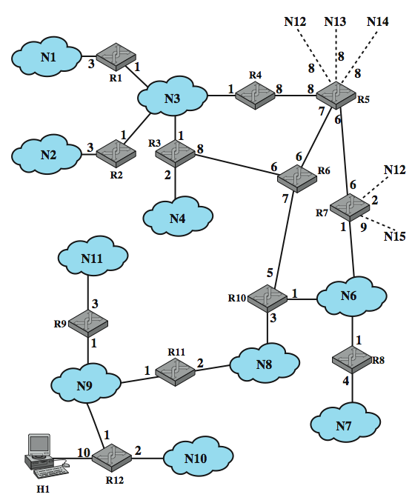
Example OSPF AS
Notes:
Stallings DCC9e Figure 19.7, based on one in RFC 2328, shows an example of an autonomous system.

Slide 41
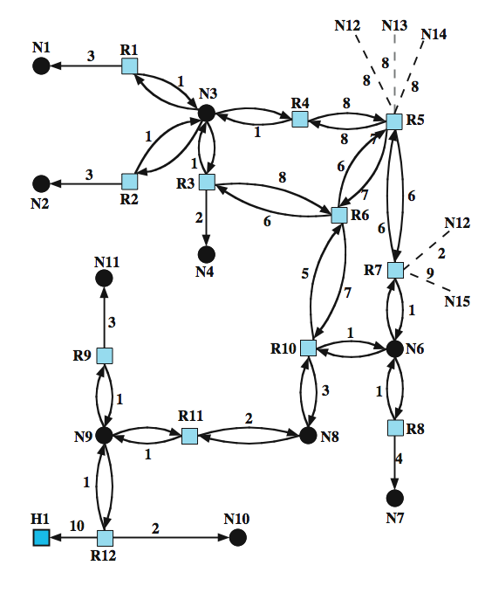
Directed Graph of AS
Notes:
Stallings DCC9e Figure 19.8 is the resulting directed graph, mapped using:
• Two routers joined by a point-to-point link are represented in the graph as being directly connected by a pair of edges, one in each direction (e.g., routers 6 and 10).
• When multiple routers are attached to a network (such as a LAN or packet-switching network), the directed graph shows all routers bi-directionally connected to the network vertex (e.g., routers 1, 2, 3, and 4 all connect to network 3).
• If a single router is attached to a network, the network will appear in the graph as a stub connection (e.g., network 7).
• An end system, called a host, can be directly connected to a router, in which case it is depicted in the corresponding graph (e.g., host 1).
• If a router is connected to other autonomous systems, then the path cost to each network in the other system must be obtained by some exterior router protocol (ERP). Each such network is represented on the graph by a stub and an edge to the router with the known path cost (e.g., networks 12 through 15).
A cost is associated with the output side of each router interface. This cost is configurable by the system administrator. Arcs on the graph are labeled with the cost of the corresponding router output interface. Arcs having no labeled cost have a cost of 0. Note that arcs leading from networks to routers always have a cost of 0.

Slide 42
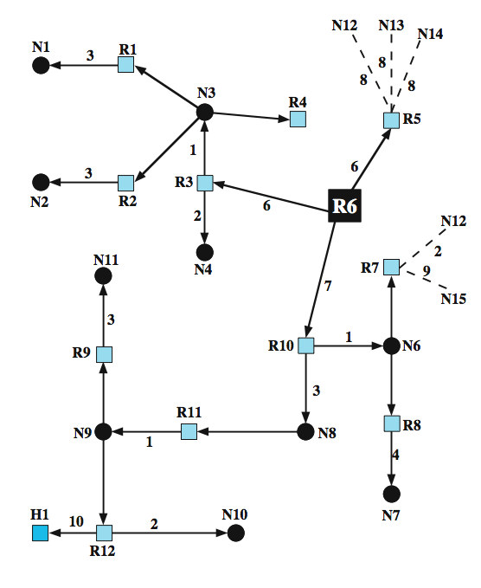
SPF Tree for Router 6
Notes:
A database corresponding to the directed graph is maintained by each router. It is pieced together from link state messages from other routers in the internet. Using Dijkstra's algorithm (see Stallings DCC9e Section 12.3), a router calculates the least-cost path to all destination networks. The result for router 6 of Stallings DCC9e Figure 19.7 is shown as a tree in Stallings DCC9e Figure 19.9, with R6 as the root of the tree. The tree gives the entire route to any destination network or host. However, only the next hop to the destination is used in the forwarding process. The resulting routing table for router 6 is shown in Stallings DCC9e Table 19.3. The table includes entries for routers advertising external routes (routers 5 and 7). For external networks whose identity is known, entries are also provided.

Slide 43
Routing Table for R6
Notes:
Stallings DCC9e Table 19.3

Slide 44
Mobile IP
enables computers to maintain Internet connectivity while moving from one Internet attachment point to another
particularly suited for wireless connections
mobile implies:
a user is connected to one or more applications across the Internet
the user’s point of attachment changes dynamically
all connections are automatically maintained despite the change
Notes:
In response to the increasing popularity of palm-top and other mobile computers, Mobile IP was developed to enable computers to maintain Internet connectivity while moving from one Internet attachment point to another. Although Mobile IP can work with wired connections, in which a computer is unplugged from one physical attachment point and plugged into another, it is particularly suited to wireless connections.
The term mobile in this context implies that a user is connected to one or more applications across the Internet, that the user's point of attachment changes dynamically, and that all connections are automatically maintained despite the change. This is in contrast to a user, such as a business traveler, with a portable computer of some sort who arrives at a destination and uses the computer's notebook to dial into an ISP (Internet service provider). In this latter case, the user's Internet connection is terminated each time the user moves and a new connection is initiated when the user dials back in. Each time an Internet connection is established, software in the point of attachment (typically an ISP) is used to obtain a new, temporarily assigned IP address. This temporary IP address is used by the user's correspondent for each application-level connection (e.g., FTP, Web connection). A better term for this kind of use is nomadic.
We begin with a general overview of Mobile IP and then look at some of the details.

Slide 45
Operation of Mobile IP
routers use the IP address in an IP datagram to perform routing
network portion is used to move a datagram to the network the target computer is attached to
final router uses the host portion to deliver to the destination
with a mobile host the IP address may change while one or more TCP connections are active
Notes:
Operation of Mobile IP
As was described earlier in this chapter, routers make use of the IP address in an IP datagram to perform routing. In particular, the network portion of an IP address (Figure 18.6) is used by routers to move a datagram from the source computer to the network to which the target computer is attached. Then the final router on the path, which is attached to the same network as the target computer, uses the host portion of the IP address to deliver the IP datagram to the destination. Further, this IP address is known to the next higher layer in the protocol architecture (Figure 18.1). In particular, most applications over the Internet are supported by TCP connections. When a TCP connection is set up, the TCP entity on each side of the connection knows the IP address of the correspondent host. When a TCP segment is handed down to the IP layer for delivery, TCP provides the IP address, and IP creates an IP datagram with that IP address in the IP header and sends the datagram out for routing and delivery. However, with a mobile host, the IP address may change while one or more TCP connections are active.

Slide 46
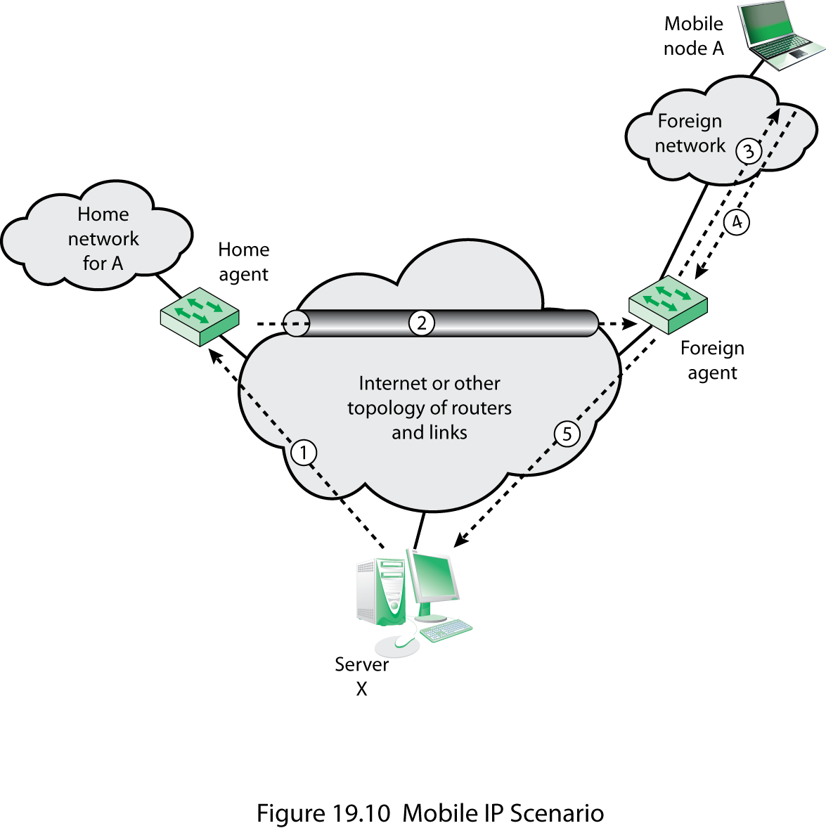
Mobile IP Scenario
Notes:
Stallings 9e Figure 19.10 shows in general terms how Mobile IP deals with the problem of dynamic IP addresses. A mobile node is assigned to a particular network, known as its home network. Its IP address on that network, known as its home address, is static. When the mobile node moves its attachment point to another network, that network is considered a foreign network for this host. Once the mobile node is reattached, it makes its presence known by registering with a network node, typically a router, on the foreign network known as a foreign agent. The mobile node then communicates with a similar agent on the user's home network, known as a home agent, giving the home agent the care-of address of the mobile node; the care-of address identifies the foreign agent's location. Typically, one or more routers on a network will implement the roles of both home and foreign agents.

Slide 47
Basic Capabilities of Mobile IP
Mobile IP includes three basic capabilities
Discovery
a discovery procedure is used to identify prospective home and foreign agents
Registration
authenticated registration procedure is used
Tunneling
forwards IP datagram from a home address to a care-of address
Notes:
To support the operations illustrated in Stallings DCC9e Figure 19.10, Mobile IP includes three basic capabilities:
Discovery: A mobile node uses a discovery procedure to identify prospective home agents and foreign agents.
Registration: A mobile node uses an authenticated registration procedure to inform its home agent of its care-of address.
Tunneling: Tunneling is used to forward IP datagrams from a home address to a care-of address.

Slide 48
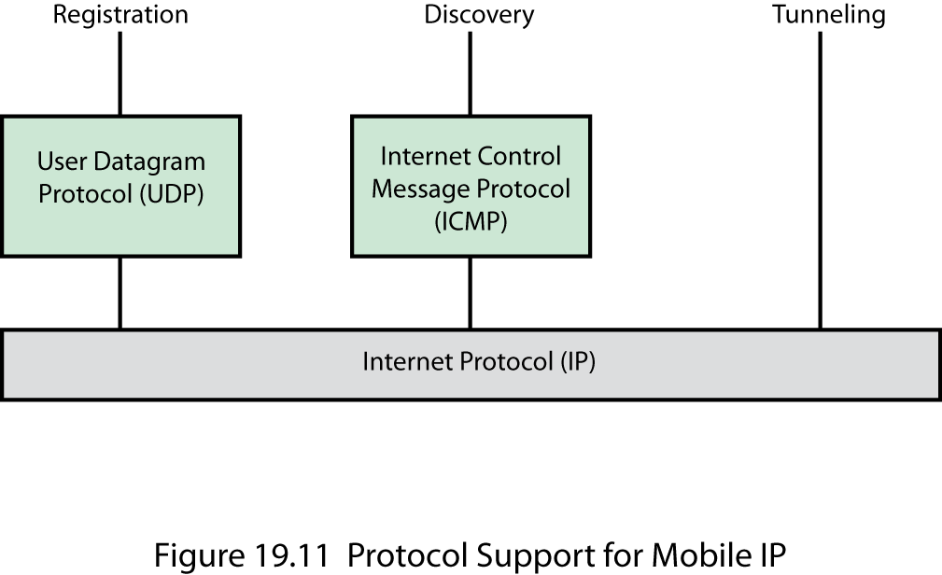
Mobile IP Protocol Support
Notes:
Stallings DCC9e Figure 19.11 indicates the underlying protocol support for the Mobile IP capability. The registration protocol communicates between an application on the mobile node and an application in the home agent and hence uses a transport-level protocol. Because registration is a simple request-response transaction, the overhead of the connection-oriented TCP is not required, and therefore UDP is used as the transport protocol. Discovery makes use of the existing ICMP (Internet Control Message Protocol) by adding the appropriate extensions to the ICMP header. Finally, tunneling is performed at the IP level.

Slide 49
Mobile IP Terminology (RFC 3334)
Notes:
Stallings DCC9e Figure 19.4
Mobile IP is specified in a number of RFCs. The basic defining document is RFC 3344. Table 19.4 lists some useful terminology from RFC 3344.

Slide 50
Discovery
similar to the router advertisement process defined in ICMP
mobile node is responsible for an ongoing discovery process
home or foreign network
listens for agent advertisement message
compares IP address with home address
If these do not match the mobile node is on a foreign network
Notes:
Discovery
The discovery process in Mobile IP is very similar to the router advertisement process defined in ICMP. Accordingly, agent discovery makes use of ICMP router advertisement messages, with one or more extensions specific to Mobile IP.
The mobile node is responsible for an ongoing discovery process. It must determine if it is attached to its home network, in which case IP datagrams may be received without forwarding, or if it is attached to a foreign network. Because handoff from one network to another occurs at the physical layer, a transition from the home network to a foreign network can occur at any time without notification to the network layer (i.e., the IP layer). Thus, discovery for a mobile node is a continuous process.
For the purpose of discovery, a router or other network node that can act as an agent periodically issues a router advertisement ICMP message (Stallings DCC9e Figure 18.8d) with an advertisement extension. The router advertisement portion of the message includes the IP address of the router. The advertisement extension includes additional information about the router's role as an agent, as discussed subsequently. A mobile node listens for these agent advertisement messages. Because a foreign agent could be on the mobile node's home network (set up to serve visiting mobile nodes), the arrival of an agent advertisement does not necessarily tell the mobile node that it is on a foreign network. The mobile node must compare the network portion of the router's IP address with the network portion of its own home address. If these network portions do not match, then the mobile node is on a foreign network.
The agent advertisement extension follows the ICMP router advertisement fields. The extension includes the following one-bit flags:
R: Registration with this foreign agent is required (or another foreign agent on this network). Even those mobile nodes that have already acquired a care-of address from this foreign agent must re-register.
B: Busy. The foreign agent will not accept registrations from additional mobile nodes.
H: This agent offers services as a home agent on this network.
F: This agent offers services as a foreign agent on this network.
M: This agent can receive tunneled IP datagrams that use minimal encapsulation, explained subsequently.
G: This agent can receive tunneled IP datagrams that use GRE encapsulation, explained subsequently.
r: reserved.
T: Foreign agent supports reverse tunneling.
In addition, the extension includes zero or more care-of addresses supported by this agent on this network. There must be at least one such address if the F bit is set. There may be multiple addresses.

Slide 51
Use of Lifetime Field
upon receipt of an agent advertisement from a foreign agent the mobile node records the lifetime field as a timer
if timer expires before receipt of another advertisement, node assumes it lost contact
if node has received an advertisement that is not expired, node registers with the new agent
otherwise, node uses agent solicitation to find an agent
Notes:
MOVE DETECTION
As was mentioned, a mobile node may move from one network to another due to some handoff mechanism, without the IP level being aware of it. The agent discovery process is intended to enable the agent to detect such a move. The agent may use one of two algorithms for this purpose:
Use of lifetime field: When a mobile node receives an agent advertisement from a foreign agent that it is currently using or that it is now going to register with, it records the lifetime field as a timer. If the timer expires before the mobile node receives another agent advertisement from the agent, then the node assumes that it has lost contact with that agent. If, in the meantime, the mobile node has received an agent advertisement from another agent and that advertisement has not yet expired, the mobile node can register with this new agent. Otherwise, the mobile node should use agent solicitation to find an agent.

Slide 52
Use of Network Prefix
mobile node checks if newly received agent advertisement is on the same network as the node’s current care-of address
if it is not, the node assumes it moved and registers with advertisement the node has just received
Notes:
Use of network prefix: The mobile node checks whether any newly received agent advertisement is on the same network as the node's current care-of address. If it is not, the mobile node assumes that it has moved and may register with the agent whose advertisement the mobile node has just received.

Slide 53
Co-Located Address
node may move to a network that has no foreign agents or foreign agents are busy
may act as its own foreign agent by using a co-located care-of address
co-located care-of address is an IP address that is associated with the node’s current interface to a network
can dynamically acquire a temporary IP address
co-located address may be owned by the node
Notes:
CO-LOCATED ADDRESSES
The discussion so far has involved the use of a care-of address associated with a foreign agent; that is, the care-of address is an IP address for the foreign agent. This foreign agent will receive datagrams at this care-of address, intended for the mobile node, and then forward them across the foreign network to the mobile node. However, in some cases a mobile node may move to a network that has no foreign agents or on which all foreign agents are busy. As an alternative, the mobile node may act as its own foreign agent by using a co-located care-of address. A co-located care-of address is an IP address obtained by the mobile node that is associated with the mobile node's current interface to a network.
The means by which a mobile node acquires a co-located address is beyond the scope of Mobile IP. One means is to dynamically acquire a temporary IP address through an Internet service such as DHCP (Dynamic Host Configuration Protocol). Another alternative is that the co-located address may be owned by the mobile node as a long-term address for use only while visiting a given foreign network.

Slide 54
Registration
once care-of address is acquired the mobile node needs to request the home agent forward its IP traffic
registration process:
if node is using a co-located care-of address it registers directly with its home agent
node sends a registration request to the foreign agent requesting forwarding service
foreign agent relays request to home agent
home agent accepts or denies request
foreign agent relays reply to node
Notes:
Registration
Once a mobile node has recognized that it is on a foreign network and has acquired a care-of address, it needs to alert a home agent on its home network and request that the home agent forward its IP traffic. The registration process involves four steps:
1. The mobile node requests the forwarding service by sending a registration request to the foreign agent that the mobile node wants to use.
2. The foreign agent relays this request to the mobile node's home agent.
3. The home agent either accepts or denies the request and sends a registration reply to the foreign agent.
4. The foreign agent relays this reply to the mobile node.
If the mobile node is using a co-located care-of address, then it registers directly with its home agent, rather than going through a foreign agent.

Slide 55
Registration Messages
registration operation uses two types of messages carried in UDP segments
registration request message includes:
one-bit flags
home address field
home agent field
care-of address field
identification field
registration reply message includes:
acceptance code
reason for denial
Notes:
The registration operation uses two types of messages, carried in UDP segments. The registration request message includes the following one-bit flags:
S: Simultaneous bindings. The mobile node is requesting that the home agent retain its prior mobility bindings. When simultaneous bindings are in effect, the home agent will forward multiple copies of the IP datagram, one to each care-of address currently registered for this mobile node. Multiple simultaneous bindings can be useful in wireless handoff situations, to improve reliability.
B: Broadcast datagrams. Indicates that the mobile node would like to receive copies of broadcast datagrams that it would have received if it were attached to its home network.
D: Decapsulation by mobile node. The mobile node is using a co-located care-of address and will decapsulate its own tunneled IP datagrams.
M: Indicates that the home agent should use minimal encapsulation, explained subsequently.
G: Indicates that the home agent should use GRE encapsulation, explained subsequently.
T: Reverse tunneling requested.
In addition, the message includes the following fields:
Home Address: The home IP address of the mobile node. The home agent can expect to receive IP datagrams with this as a destination address, and must forward those to the care-of address.
Home Agent: The IP address of the mobile node's home agent. This informs the foreign agent of the address to which this request should be relayed.
Care-Of Address: The IP address at this end of the tunnel. The home agent should forward IP datagrams that it receives with mobile node's home address to this destination address.
Identification: A 64-bit number generated by the mobile node, used for matching registration requests to registration replies and for security purposes, as explained subsequently.
Extensions: The only extension so far defined is the authentication extension, explained subsequently.
The registration reply message includes a code that indicates whether the request is accepted and, if not, the reason for denial.

Slide 56
Registration Security
mobile IP is designed to resist two types of attacks:
node pretends to be a foreign agent and sends registration request to home agent to divert traffic
malicious agent may replay old registration messages effectively cutting node from the network
Notes:
SECURING THE REGISTRATION PROCEDURE
A key concern with the registration procedure is security. Mobile IP is designed to resist two types of attacks:
1. A node may pretend to be a foreign agent and send a registration request to a home agent so as to divert traffic intended for a mobile node to itself.
2. A malicious agent may replay old registration messages, effectively cutting the mobile node from the network.

Slide 57
Message Authentication
three types of authentication extensions:
mobile-home
mobile-foreign
foreign-home
message authentication is used to protect against registration message attacks
authentication extension includes the following fields:
security parameter index (SPI)
authenticator
Notes:
The technique that is used to protect against such attacks involves the use of message authentication and the proper use of the identification field of the registration request and reply messages.
For purposes of message authentication, each registration request and reply contains an authentication extension, which includes the following fields:
Security Parameter Index (SPI): An index that identifies a security context between a pair of nodes. This security context is configured so that the two nodes share a secret key and parameters relevant to this association (e.g., authentication algorithm).
Authenticator: A code used to authenticate the message. The sender inserts this code into the message using a shared secret key. The receiver uses the code to ensure that the message has not been altered or delayed. The authenticator protects the entire registration request or reply message, any extensions prior to this extension, and the type and length fields of this extension.
The default authentication algorithm is HMAC-MD5, defined in RFC 2104, which produces a 128-bit message digest. HMAC-MD4 is an example of what is known as a keyed hash code. Appendix R describes such codes. The digest is computed over a shared secret key, and the protected fields from the registration message.
Three types of authentication extensions are defined:
Mobile-home: This extension must be present and provides for authentication of the registration messages between the mobile node and the home agent.
Mobile-foreign: The extension may be present when a security association exists between the mobile node and the foreign agent. The foreign agent will strip this extension off before relaying a request message to the home agent and add this extension to a reply message coming from a home agent.
Foreign-home: The extension may be present when a security association exists between the foreign agent and the home agent.
Note that the authenticator protects the identification field in the request and reply messages. As a result, the identification value can be used to thwart replay types of attacks. As was mentioned, the identification value enables the mobile node to match a reply to a request. Further, if the mobile node and the home agent maintain synchronization, so that the home agent can distinguish a reasonable identification value from a suspicious one, then the home agent can reject suspicious messages. One way to do this is to use a timestamp value. As long as the mobile node and home agent have reasonably synchronized values of time, the timestamp will serve the purpose. Alternatively, the mobile node could generate values using a pseudorandom number generator. If the home agent knows the algorithm, then it knows what identification value to expect next.

Slide 58
Tunneling
once a mobile node is registered with a home agent the agent must be able to intercept IP datagrams to be forwarded
references ARP as a possible mechanism
home agent steals the identity of the mobile node in order to capture packets destined for that node
encapsulation for Mobile IP:
IP-within-IP (RFC 2003)
Minimal (RFC 2004)
generic routing (RFC 1701)
Notes:
Tunneling
Once a mobile node is registered with a home agent, the home agent must be able to intercept IP datagrams sent to the mobile node's home address so that these datagrams can be forwarded via tunneling. The standard does not mandate a specific technique for this purpose but references ARP (Address Resolution Protocol) as a possible mechanism. The home agent needs to inform other nodes on the same network (the home network) that IP datagrams with a destination address of the mobile node in question should be delivered (at the link level) to this agent. In effect, the home agent steals the identity of the mobile node in order to capture packets destined for that node that are transmitted across the home network.
For example, suppose that R3 in Stallings DCC9e Figure 19.12 is acting as the home agent for a mobile node that is attached to a foreign network elsewhere on the Internet. That is, there is a host H whose home network is LAN Z that is now attached to some foreign network. If host D has traffic for H, it will generate an IP datagram with H's home address in the IP destination address field. The IP module in D recognizes that this destination address is on LAN Z and so passes the datagram down to the link layer with instructions to deliver it to a particular MAC-level address on Z. Prior to this time, R3 has informed the IP layer at D that datagrams destined for that particular address should be sent to R3. Thus, D inserts the MAC address of R3 in the destination MAC address field of the outgoing MAC frame. Similarly, if an IP datagram with the mobile node's home address arrives at router R2, it recognizes that the destination address is on LAN Z and will attempt to deliver the datagram to a MAC-level address on Z. Again, R2 has previously been informed that the MAC-level address it needs corresponds to R3.
For traffic that is routed across the Internet and arrives at R3 from the Internet, R3 must simply recognize that for this destination address, the datagram is to be captured and forwarded.
To forward an IP datagram to a care-of address, the home agent puts the entire IP datagram into an outer IP datagram. This is a form of encapsulation, just as placing an IP header in front of a TCP segment encapsulates the TCP segment in an IP datagram. Three options for encapsulation are allowed for Mobile IP:
IP-within-IP encapsulation: This is the simplest approach, defined in RFC 2003.
Minimal encapsulation: This approach involves fewer fields, defined in RFC 2004.
Generic routing encapsulation (GRE): This is a generic encapsulation procedure that was developed prior to the development of Mobile IP, defined in RFC 1701.

Slide 59
IP-Within-IP Encapsulation
entire IP datagram becomes the payload in a new IP datagram
inner, original IP header is unchanged except to decrement TTL by 1
outer header is a full IP header
two fields are copied from the inner header:
version number 4 (IPv4)
type of service requested for the outer IP datagram is the same as that requested for the inner IP datagram
Notes:
IP-WITHIN-IP ENCAPSULATION
With this approach, the entire IP datagram becomes the payload in a new IP datagram (Stallings DCC9e Figure 19.13a). The inner, original IP header is unchanged except to decrement TTL by 1. The outer header is a full IP header. Two fields (indicated as un-shaded in the figure) are copied from the inner header: The version number is 4, which is the protocol identifier for IPv4, and the type of service requested for the outer IP datagram is the same as that requested for the inner IP datagram.
In the inner IP header, the source address refers to the host that is sending the original datagram, and the destination address is the home address of the intended recipient. In the outer IP header, the source and destination addresses refer to the entry and exit points of the tunnel. Thus, the source address typically is the IP address of the home agent, and the destination address is the care-of address for the intended destination.

Slide 60
Minimal Encapsulation
the new header is inserted between the original IP header and the original IP payload
includes the following fields:
fields in the original IP header modified to form the new outer IP header are:
Total length
Protocol
Header checksum
Source and destination addresses
Destination address
Protocol
S
Header checksum
Original source and destination addresses
Notes:
MINIMAL ENCAPSULATION
Minimal encapsulation results in less overhead and can be used if the mobile node, home agent, and foreign agent all agree to do so. With minimal encapsulation, the new header is inserted between the original IP header and the original IP payload (Stallings DCC9e Figure 19.13b). It includes the following fields:
Protocol: Copied from the destination address field in the original IP header. This field identifies the protocol type of the original IP payload and thus identifies the type of header than begins the original IP payload.
S: If 0, the original source address is not present, and the length of this header is 8 octets. If 1, the original source address is present, and the length of this header is 12 octets.
Header Checksum: Computed over all the fields of this header.
Original Destination Address: Copied from the destination address field in the original IP header.
Original Source Address: Copied from the source address field in the original IP header. This field is present only if the S bit is 1. The field is not present if the encapsulator is the source of the datagram (i.e., the datagram originates at the home agent).
The following fields in the original IP header are modified to form the new outer IP header:
Total Length: Incremented by the size of the minimal forwarding header (8 or 12).
Protocol: 55; this is the protocol number assigned to minimal IP encapsulation.
Header Checksum: Computed over all the fields of this header; because some of the fields have been modified, this value must be recomputed.
Source Address: The IP address of the encapsulator, typically the home agent.
Destination Address: The IP address of the exit point of the tunnel. This is the care-of address and may either be the IP address of the foreign agent or the IP address of the mobile node (in the case of a co-located care-of address).
The processing for minimal encapsulation is as follows. The encapsulator (home agent) prepares the encapsulated datagram with the format of Figure 19.13b. This datagram is now suitable for tunneling and is delivered across the Internet to the care-of address. At the care-of address, the fields in the minimal forwarding header are restored to the original IP header and the forwarding header is removed from the datagram. The total length field in the IP header is decremented by the size of the minimal forwarding header (8 or 12) and the header checksum field is recomputed.

Slide 61

Summary
multicasting
IGMP
routing protocols
BGP, OSPF
mobile IP
operation, discovery, registration, tunneling
Notes:
Stallings DCC9e Chapter19 summary.

